Slide 1

Climate change and Disaster risk reduction
Director of Climate Finance Center of the Kyrgyz Republic
Abdrahmanov K.J.
High-level
Development Forum
November 19, 2019

Slide 2

Introduction and general
Kyrgyzstan is a country extremely vulnerable to the effects of climate change, extreme weather events and natural disasters in the Central Asian region;
The expected economic losses/damage due to climate change in the absence of adaptation actions are estimated at more than $1,2 billion USD;
Climate change threatens the achievement of all Sustainable Development Goals (SDG).
Transition to Sustainable Development makes it necessary to include response measures to climate change in all aspects of policy and planning.

Slide 3
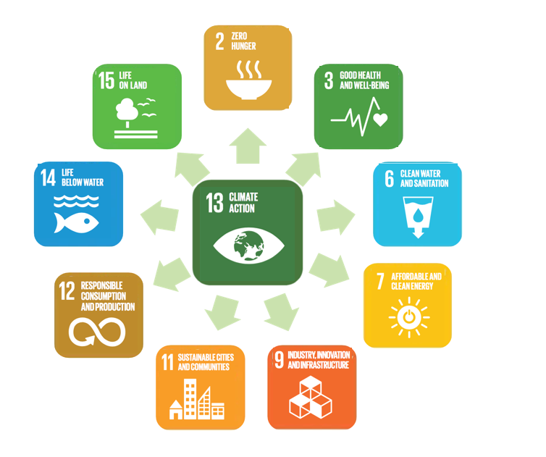
SDG 13 –
Climate change will have a direct or indirect impact on the achievement of 10 sustainable development goals.

Slide 4






Vulnerable sectors of the KR economy
  Water sector - glacial melt, water scarcity, lack of clean drinking water –
    loss/damage: $718 million USD
  Energy (Hydropower) – threat to the hydro-energy security of the Kyrgyz Republic due to lack of water resources –
      loss/damage: $200 million USD
  Agriculture – land degradation, risks for crops, threat to food security –
      loss/damage: $70 million USD
  Biodiversity (natural capital) – degradation of natural resources and forests, loss of biodiversity –
      loss/damage: $94.8 million USD
  Health - increase in the number of cardiovascular and bacterial infections –
      loss/damage: $110 million USD

Slide 5
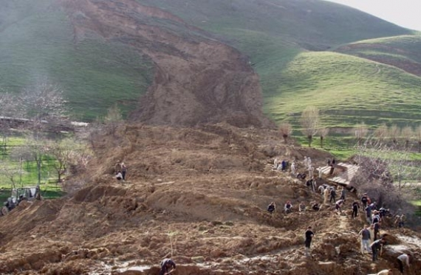
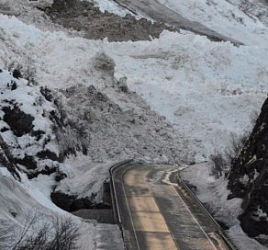
Disaster risk reduction
An increase in natural disasters such as mudflows, floods, avalanches, landslides and natural fires.
The total annual damage to the population and economy of the Kyrgyz Republic amounted to $60 million USD as a result of flood damage and $2.6 million USD as a result of landslide damage.
By 2050, an estimated 6.6 million people in the KR will be at risk from their exposure.
    It is necessary to increase resilience and ability to adapt to dangerous climatic events and natural disasters.

Slide 6
Climate change - catalyst for action
Climate Change
Disaster Risks Reduction
SDGs Achievement
Lack of climate action is a threat in achieving the SDGs.
The purpose of adaptation is to minimize economic losses.
Using climate change as a catalyst for risk reduction, the country will accelerate the achievement of Sustainable Development Goals.

Slide 7
Legal and Strategic framework
Water Code of the Kyrgyz Republic;
Law № 125 dated 11.11.19 «About Ratification of Paris Agreement»;
National Development Strategy of the Kyrgyz Republic for 2018-2040 (President Decree № 221 dated 31.10.18);
Government Program of the Kyrgyz Republic for 2018-2022 “Unity. Trust. Creation”.
The Green Economy Program for the period of 2019-2023 and implementation plan (Government Decree № 605 dated 14.11.19);
Concept of protection of population and territories from natural and technological emergencies for 2018-2030 and The concept implementation action plan until 2022;
Climate Investment Program (CIP);
Priority sectors on adaptation to climate change in the Kyrgyz Republic until 2017 (outdated, updating is necessary).

Slide 8
progress since 2013
In Climate Change and the Green Economy:
CCCCP
2012
Priority directions for adaptation to climate change in the Kyrgyz Republic until 2017
Signing of the Paris Agreement UNFCCC 2016
INDC KR
3 NCs, preparation of
4th NC
CFC 2018
Creation of NAWR
Program and plan of the green economy development in the KR for 2019-2023
SPCR CIF
2015
2 projects approved,
2 concepts
sent to GCF
Ratification of the Paris Agreement

Slide 9
progress since 2013
Disaster risk reduction:
Creation and development of comprehensive monitoring and forecasting system for emergencies
Institutional strengthening and capacity building of the KyrgyzHydromet
Weather Station Automation
Unified information and management system of the Kyrgyz Republic in emergency and crisis situations (EIUS)
The Crisis Management Center
National Integrated Public Information and Warning System (OKSION)
Unified State duty dispatch Service 112

Slide 10


Strategic orientation
For a clear strategic orientation, it is important that national and sectoral programs be well designed and successfully implemented, taking into account the existing linkages between them.
National adaptation Program (NAP) and sectoral adaptation plans: Agriculture, water resources, emergencies, energy, health, forest and biodiversity;
National-determined contribution (NDC) of the country within the framework of commitments under the Paris Agreement;
Program of the Green Economy of the Kyrgyz Republic for the period of 2019-2023;
Road Map for the implementation of The Water Code, as well as adoption and implementation of the National Water Strategy;
Climate Investments Program (CIP).

Slide 11






Climate change and green economy coordination mechanism
Coordination Council on Climate Change and the Green Economy
  Chaired by Prime Minister of the Kyrgyz Republic
- Identifies national priority programs, reviews and approves policies and projects;
- Defines a common strategy for cooperation with all international organizations and climate funds;
- Identifies national focal points in international organizations;
- Reviews project implementation reports.
CFC KR:
Secretariat of the Coordination Council;
GCF NDA Secretariat (MoE KR);
GCF Focal Point;
- CTCN NDE.
SAEPF KR
Global Environment Facility
Adaptation Fund
Ministry of Economy
GCF NDA
Green Climate Fund
Notes:
В связи с этим, предлагается новая структура по координации в рамках зеленого и климатического финансирования в КР

Slide 12
Priority actions and tasks
Strategic orientation: implementation of NAP, NDC, CIP
and the Green Economy Program
Strengthening the technical capacity of the Emergency Response Forces
Creating an enabling legal and institutional environment
Reform of regulatory and financial systems
Raising Climate Change Awareness, Capacity and Knowledge
Development of an integrated emergency monitoring and forecasting system
Notes:
Создание благоприятной правовой и институциональной среды для привлечения климатического финансирования и эффективной реализации мер по смягчению последствий и адаптации к изменению климата в стране (базовая предпосылка);
Повышение информированности, потенциала и знаний по вопросам изменения климата как населения, так и лиц, принимающих решения на всех уровнях власти;
Реформирование регуляторных и финансовых систем для стимулирования зеленых инвестиций и технологий;
Дальнейшее развитие системы комплексного мониторинга и прогнозирования опасных природных процессов и явлений (исследования, система раннего оповещения, мониторинг и прогнозирование);
Меры по снижению рисков от склоновых процессов, деградации земель в условиях адаптации к изменениям климата и снижения рисков бедствий;
Усиление технического потенциала сил реагирования на ЧС;
Реализация стратегических национальных и отраслевых программ.

Slide 13
regulatory and financial SYSTEMS reform
Tariff and Fiscal Policy
Sustainable Financing
Green Procurement
Green Subsidies
Environmental safety standards
Insurance
Technical norms
Ecological expertise, monitoring and control
Notes:
Внедрение принципов устойчивого финансирования;
Эффективная тарифная и фискальная политика;
Пересмотр политики субсидирования;
Пересмотр процедуры госзакупок с учетом климатического и экологического фактора;
Развитие страхования от стихийных бедствий, выработка механизмов стимулирования внутренних инвестиций
Внедрение обязательных к исполнению стандартов экологической безопасности, строительных и производственных норм и правил;
Обеспечение эффективного функционирования инструментов государственного контроля и усиление системы экологической экспертизы, мониторинга и контроля.

Slide 14


CLIMATE FINANCING OPPORTUNITIES for Kyrgyzstan
For 2016, climate financing, taken into account in the UNFCCC, amounted to $74.5 billion per year.
In 2019, MDBs announced a commitment to achieve a total CF of at least $65 billion a year by 2025, and also double total funding for adaptation measures to $18 billion annually by 2025 compared to the current level (Climate Summit outcomes on September 23, of this year).
The first official replenishment of the GCF already amounted to almost $9 billion USD (as of October 20, 2019).
Since 2025, total climate finance should reach $100 billion annually.
Implementation of measures in the Kyrgyz Republic requires nearly $2 billion USD.
Notes:
Необходимость структурных изменений и решительных действий со стороны Правительства КР. Некоторые из необходимых реформ могут показаться дорогостоящими или болезненными в краткосрочном периоде, но они необходимы и экономически выгодны в долгосрочной перспективе.

Slide 15
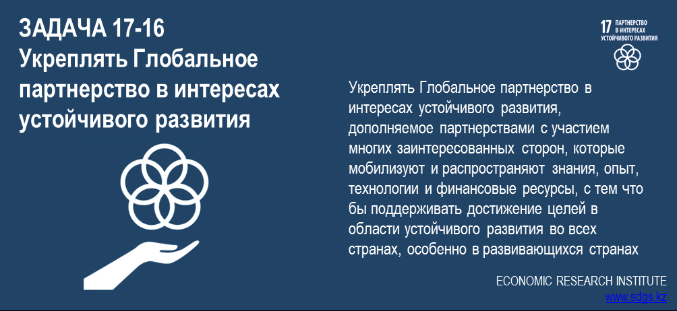
Strengthening Partnerships for Development
Development partners
Government
NGOs
Academia
The need to join efforts to effectively implement climate measures.
Official Development Aid - important source of support for climate action in the Kyrgyz Republic.
Business

Slide 16

THANK YOU FOR YOUR ATTENTION!

